Slide 1

Gotham
Phase 2 - During the changes
T-DIT-700 MSc2020
Gotham T-DIT-700

Slide 2
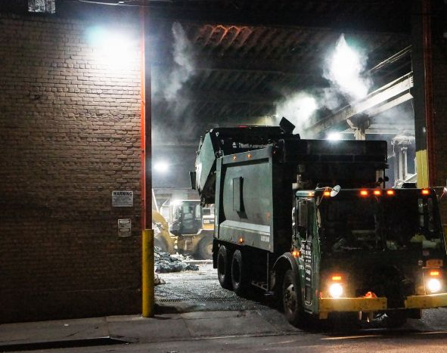
Summary 1. Introduction 2. Remainder of change 3. Communication 4. Training 5. Plan 6. Financial plan 7. Conclusion

Slide 3
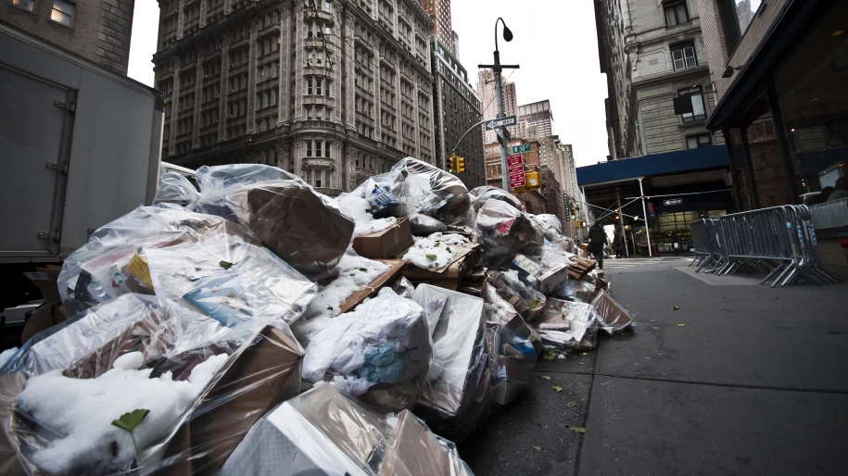
Introduction
The city hall has decided to implement a vast change plan in order to renew and reorganize its garbage collection system.
This implementation plan is in progress now.
How to facilitate this transition ?

Slide 4








Reminder of changes decided by the town hall
1- Use the working time app
2- Equip trucks with GPS
3 – Equip employees with electronic device
4 - Use drones to check the collections and the state of cleanliness of the streets
5 – Smart trashes, with sensor
6 – Public app for incident reporting
7 – Monthly performance reporting

Slide 5

Change management
Communication :
To circulate the right information at the right time
To facilitate management, and decision making
To include all employees in the change by answering their questions and listening to their recommendation as expert in their profesion.

Slide 6

Change management
Training :
Help employee feel confortable with the changes taking place
Have all the necessary knowledge to participate in innovation

Slide 7
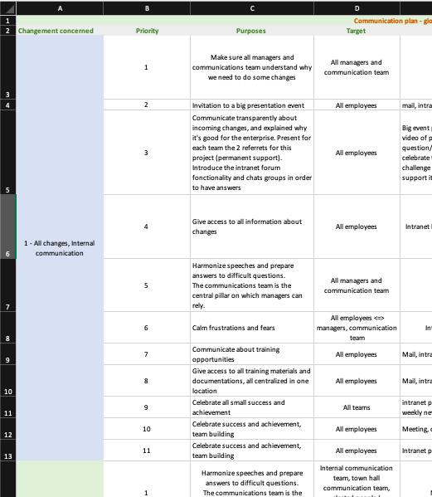
Plan everythings
Training plan and communication plan :
Plan in advance as much communication and training element as possible, to leave time for the unexpected.
Use these plans as a guideline, to stay the course.

Slide 8

Gantt
Clear representation of project tasks
Effective time management
Better resource allocation

Slide 9

Financial plan
Backed by Wayne Company funds, all costs are covered.
We also have a supplement to deal with unforeseen events

Slide 10

Thank you for listening
Do you have questions ?

